Slide 1
Chapter 22 – Impact of Diseases on Man

Slide 2
22.1 Types of Diseases
You should be able to:
■ distinguish between pathogenic, deficiency, hereditary and physiological diseases, citing examples for each;
■ distinguish among the methods used to treat and control the four main groups of diseases; and
■ discuss the social and economic implications of disease in plants and animals

Slide 3
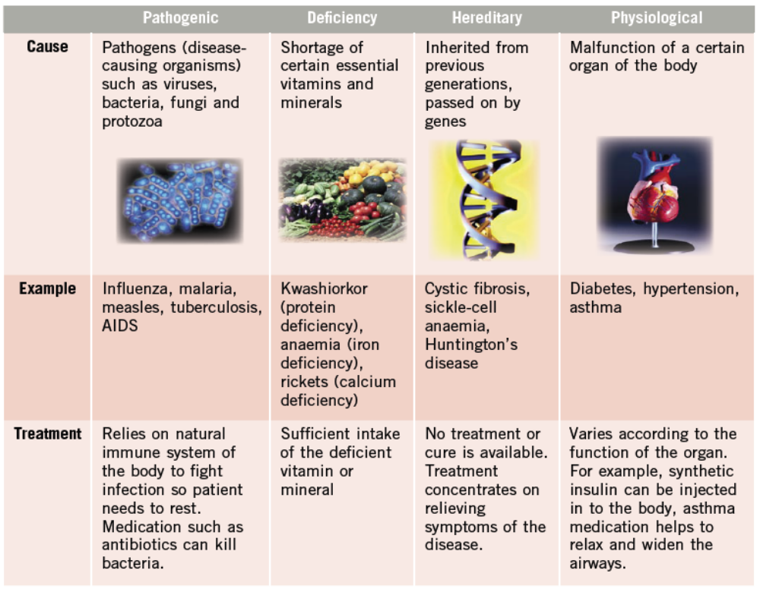
22.1 Types of Diseases
There are four different types of disease – pathogenic, deficiency, hereditary and physiological.

Slide 4
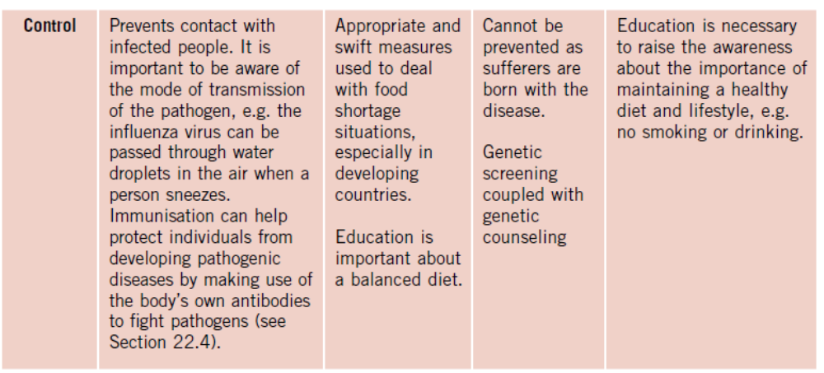
22.1 Types of Diseases

Slide 5
22.1 Types of Diseases
Implications of Disease in Plants and Animals
An outbreak of a serious disease on crops or livestock can impact man in several ways:
  loss of income to the farmers,
  cost incurred in the disposal and containment of dead animals,
  reduction in food availability for consumers, leading to a rise in prices,
  food businesses affected adversely and
  International trade relations affected, e.g. when other countries ban the import of certain meat because of cases of cattle being infected with a disease.

Slide 6
22.1 Types of Diseases
Implications of Disease in Man
Disease can affect man in the following ways:
  Loss of productivity for sick people
  Loss of life, economically and emotionally
  Loss of expertise by death
  Cost of treatment and medication for individuals
  Cost of research to combat disease
  Drain on economy for health care

Slide 7
22.2 Disease and Vectors
You should be able to:
■ explain the role of vectors in the transmission of disease;
■ identify the stages in the life history of a mosquito; and
■ suggest appropriate methods of control of each stage of the life history of a mosquito.

Slide 8
22.2 Disease and Vectors
A vector refers to an organism that transmits diseases.
The vector itself does not cause disease, but it carries the pathogen (disease-causing microorganism) from one host to another.
E.g. The Anopheles mosquito carries the malarial parasite, known as Plasmodium, parasitic protozoan, in its body and saliva. Plasmodium is harmless to the Anopheles mosquito, but causes the disease, malaria, in human beings. It reproduces in the liver and red blood cells and release the toxins into the bloodstream of humans.
Mosquitoes are also vectors for other diseases like Dengue fever. Hence, we need measures to eliminate their population so as to control the spread of the diseases.

Slide 9
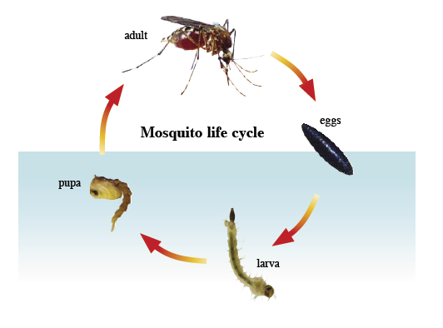
22.2 Disease and Vectors
Life Cycle of Mosquito

Slide 10
22.2 Disease and Vectors
Egg stage
Mosquitoes lay eggs in stagnant water. The eggs are either laid singly or in clusters. Most eggs will hatch within 48 hours.
Method of control:
  Get rid of stagnant water in rain gutters, old tyres or any containers or crevices where mosquitoes can breed.
  Fill pools of water with dirt.
Larvae stage (Feeding and Growing Stage)
The larvae live in water and stay near the surface to breathe. They feed on microscopic plants and animals in the water, and accumulate much food material in their bodies.

Slide 11
22.2 Disease and Vectors
Pupae stage (Stage of Internal Development)
This is the resting, non-feeding stage. The pupa relies on the food material stored during the larval stage.
Method of control:
  Spray a layer of oil on the surface of stagnant water to drown the larvae and pupae.
  Introduce fish that feed on larvae into bodies of water like ponds and lakes.
Adult mosquito (Reproductive Stage)
After this stage, the mosquito will be able to reproduce and distribute more of its species
Method of control:
  Spraying insecticides on the walls of buildings, especially dark corners.

Slide 12
22.3 Sexually Transmitted Diseases
You should be able to:
■ discuss the transmission and control of AIDS and syphilis; and
■ discuss the implications of STDs

Slide 13
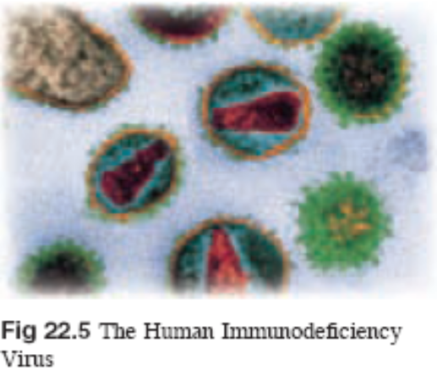
22.3 Sexually Transmitted Diseases
AIDS
AIDS stands for Acquired Immune Deficiency Syndrome.
It is caused by the Human Immunodeficiency Virus (HIV).
AIDS refers to the most advanced stages of HIV infection. The virus attacks the immune system and weakens it, causing the infected person to become very susceptible to infection. Symptoms of AIDS include:
  persistent cough or fever,
  severe and prolonged diarrhea
  pneumonia,
  Kaposi’s sarcoma (cancer of the
  blood vessels),
  candidiasis (fungal infection),
  tuberculosis.

Slide 14
22.3 Sexually Transmitted Diseases
There is currently no cure for AIDs and victims usually die from multiple infections within 2 years.
In order to keep the amount of HIV in the body at a low level and to prevent weakening of the immune system, HIV patients usually undergo a combination therapy of two or more antiretroviral drugs.
Treatment with three or more anti-HIV drugs is referred to as Highly Active Antiretroviral Therapy (HAART).
Pregnant women who are HIV-positive can take certain antiretroviral drugs to prevent transmission of the HIV to the babies. However, these could be unavailable in some countries.

Slide 15
22.3 Sexually Transmitted Diseases
Syphilis
Syphilis is caused by a bacterium Treponema pallidu. It is spread through syphilis sores found on the genital region. Sores can also be found on the lips or mouth. It is usually treated with penicillin or other antibiotics.
Primary stage. A sore develops in the genitals, rectum or mouth which heals by itself after a few weeks, but the syphilis infection remains.
Secondary stage. Aches, pains, fever and rashes may develop.
Latent stage. This stage can last for several years without symptoms, but syphilis is still present.
Tertiary stage. This might occur in some patients who are not treated. Permanent skin ulcers and lesions on joints and bones may form. Blindness, paralysis, insanity and heart failure may result.

Slide 16
22.3 Sexually Transmitted Diseases
Transmission of STDs
STDs can be transmitted from one person to another in the following ways:
  Sexual intercourse with an infected person. The bacterium or virus may be present in the seminal fluid of infected men and the vaginal fluid of infected women. During intercourse, the thin membranes lining the vagina and urethra are easily broken, allowing microorganisms to enter the bodily fluids.
  Sharing of needles between intravenous drug users.
  Transfusion of blood from an infected person.
  Passed from mother to child during pregnancy.

Slide 17
22.3 Sexually Transmitted Diseases
Control and prevention of STDs
People should either practise abstinence from sex or keep to one sexual partner uninfected with STDs.
Males should wear a condom carefully and consistently during sexual intercourse to reduce the risk of infection. Note: Condoms do not provide 100% protection against all STDs.
People should avoid drug abuse or sharing needles. Needles used in acupuncture, ear-piercing or tattooing should be thoroughly sterilised before use. Disposable ones could be used.
Infected people should refrain from having sex so as not to spread the disease.
Education on the risks of casual, unprotected sex, and how to minimise those risks should be provided for the general public.

Slide 18
22.3 Sexually Transmitted Diseases
Social Implications of AIDS
Increasing numbers of orphans who have lost their parents to AIDs. These orphans are usually homeless, and require the help of charity and aid organisations.
A strong social stigma against people afflicted with AIDS exist – they may be alienated from society and their own families.

Slide 19
22.3 Sexually Transmitted Diseases
Economic Implications of STDs
Large amounts of money being spent on research for cure.
In some countries where a relatively large proportion of the population is infected with HIV, the cost of medication and treatment can be very high for the government or the healthcare sector → a reduced Gross Domestic Product (GDP). The GDP is a total of the goods and services produced by a country, and is a measure of the economic output of a country.
Difficult for people infected with HIV to find jobs
→leads to a loss of income for them and their inability to cope with medical bills.
→For the industry, this means a loss in manpower supply.

Slide 20
22.4 Immunisation
You should be able to:
■ explain how immunisation is used in the control of communicable diseases.

Slide 21
22.4 Immunisation
Immunity refers to the natural ability of an organism to resist disease and infection.
Passive immunity means that one acquires immunity from the antibodies of another individual.
Active immunity develops when the body is directly exposed to the antigen
The natural immune response of the body can be induced artificially by immunisation, the basis of artificial active immunity.

Slide 22
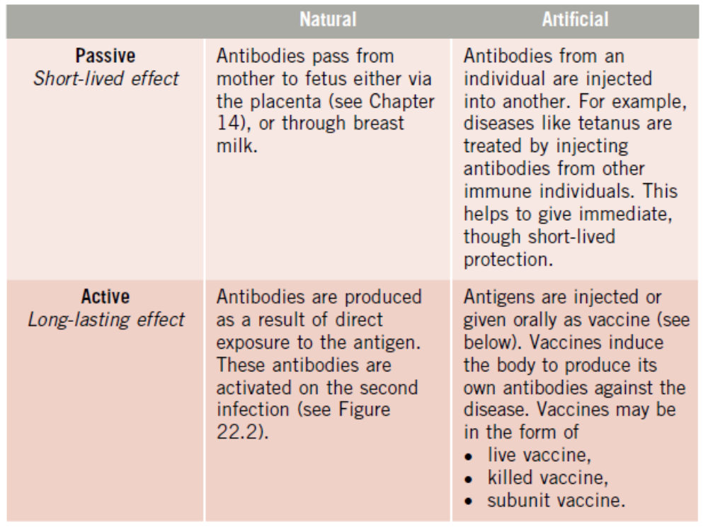
22.4 Immunisation

Slide 23
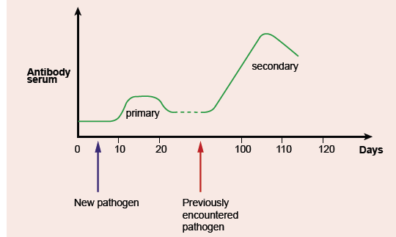
22.4 Immunisation
Active natural immunity- When a person is infected with a certain disease for the first time, antibodies will be produced by lymphocytes to destroy the pathogen. Although the antibodies are not produced in time and the disease develops, memory lymphocytes are left behind after the antigens are destroyed. Upon a secondary infection, these memory lymphocytes will be activated to produce large amounts of antibodies to destroy the antigens before symptoms of the disease develop.

Slide 24
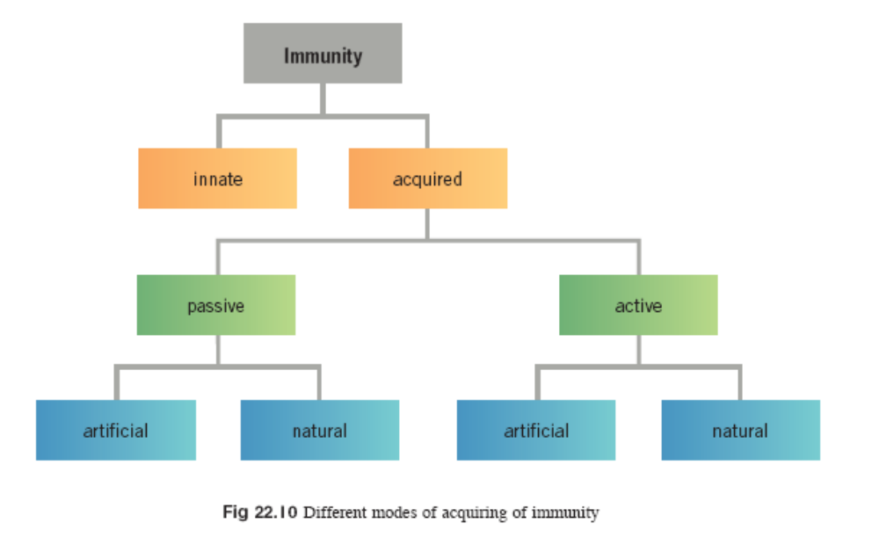
22.4 Immunisation

Slide 25
22.4 Immunisation
Types of Vaccines
Live vaccines are microorganisms which are alive but have been treated so that they are weakened and less pathogenic.
Killed vaccines are dead microorganisms that are harmless but are able to induce immunity.
Subunit vaccines. The actual organism is not used. Instead, the antigens (proteins) are transferred to a harmless vector such as yeast. These vaccines are developed to reduce the risk of infection.

Slide 26
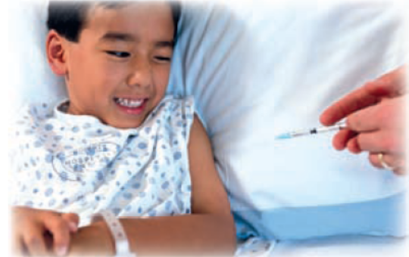
22.4 Immunisation
Immunisation Programmes
Babies have a natural immunity from the antibodies in their mother’s milk but the effect wears off after some time.
THEREFORE,
Some countries have immunisation programmes where immunisations are given several times periodically to ensure long-lasting protection against diseases.
Vaccinations protect children from tuberculosis, diphtheria, polio, measles, mumps and rubella.

Slide 27
22.5 Drugs
You should be able to:
■ discuss the physiological, social and economic effects of drug abuse.

Slide 28
22.5 Drugs
Drugs can be understood as chemical substances that alter normal body functions and metabolism.
Drugs are introduced into the body from external sources, and can be administered in the following ways:
  Consumed orally, absorbed by the stomach,
  Inhaled into the lungs as a vapour,
  Injected into the muscles or veins,
  Applied to the skin.

Slide 29

22.5 Drugs
Drug Abuse
Drug abuse, or substance abuse, refers to the excessive use of chemical substances to achieve a particular effect, usually pleasure, rather than for medical purposes.
The effects range from mild, like caffeine, to powerful, as in the case of psychoactive drugs.
Classes of drugs that can lead to abuse and addiction are:
  Stimulants
  depressants; and
  hallucinogens.

Slide 30
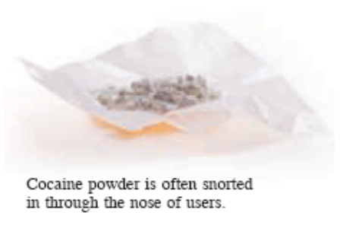
22.5 Drugs
Stimulants
Stimulants heighten mental alertness and physical activity.
A very common, legal drug found in many beverages like coffee, tea and cola is caffeine.
Too much caffeine can cause headaches and anxiety.
Cocaine
Cocaine is a highly addictive drug. A user feels very energetic and experiences a sense of euphoria (extreme happiness), commonly described as ‘high’. Cocaine abuse can cause heart attacks, irregular heartbeat, seizures and respiratory failure.

Slide 31
22.5 Drugs
Depressants
Depressants are drugs that slow down the transmission of nerve impulses in the human nervous system.
Alcohol and tranquilisers are examples of depressants.

Slide 32
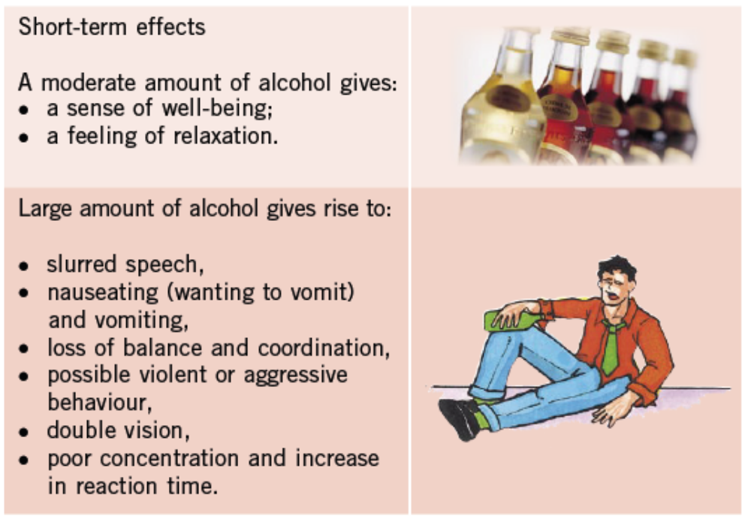
22.5 Drugs
Alcohol

Slide 33
22.5 Drugs
Alcohol
Long-term health effects of abuse:
        Physical and psychological dependence on alcohol can lead to severe withdrawal symptoms like sweating, shaking, and even seizures and hallucinations.
        Malnutrition and deficiency diseases result as alcoholics often have poor dietary habits.
        Stomach ulcers develop as alcohol stimulates the stomach lining to produce gastric juice containing hydrochloric acid.
        Liver damage (death of liver cells), liver cirrhosis (the formation of fibrous scar tissue instead of new cells to replace dead cells) and liver cancer can occur.
        Coronary heart disease and high blood pressure can result.
        Confusion, numbness and memory loss can develop.

Slide 34
22.5 Drugs
Tranquilisers
They are known as sedatives and used to reduce a person’s anxiety and help him sleep.
Usage over long periods of times makes a person develop physical or psychological dependence on it.
Without the drug, the users may suffer from withdrawal symptoms.
Tranquilisers are prescribed drugs.
It is always advisable to read the instructions and precautions to avoid misuse and neglect of side effects the drug may have.

Slide 35
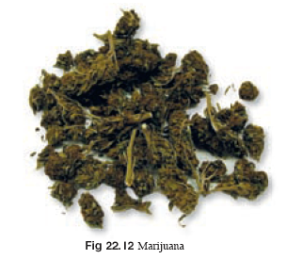
22.5 Drugs
Hallucinogens
Hallucinogens are drugs that cause alterations in mood or thought, and in some cases, cause hallucinations.
Marijuana
Marijuana has the following effects:
Short-term
  an initial ‘high’ sensation,
  distorted perception,
  difficulty in problem solving,
  difficulty in memory and learning,
  loss of coordination.
Long-term effects include addiction, and risk of bronchitis and emphysema.

Slide 36
22.5 Drugs
Misuse of antibiotics
Although antibiotics are highly effective drugs against bacterial infections, their misuse has led to severe problems in the health and medical industry.
Patients who take antibiotics for too short a duration, for example, if they do not complete the full course of the prescription, will run the risk of having antibiotic-resistant bacteria develop in their bodies.
When they take the same antibiotic next time, it will not be effective against the resistant bacteria.

Slide 37
22.5 Drugs
Social and Economic Implications of Drug Abuse
Health and economy
  Damages the health of a person, affecting his or her ability to work.
  Requires costly medical care
  Drug addicts might turn to crime to get money.
Drugs and Family
  Families have to suffer emotional distress.
  Economic hardship may result.
  Family unit suffers as children do not get adequate parental care and support.

Slide 38
Key Concepts
Diseases can be grouped into four categories – pathogenic, hereditary, deficiency and physiological. Infectious diseases are those that are caused by pathogens.
A vector transmits diseases from one host to another.
A mosquito’s life cycle has 4 stages – larva, pupae, and adult. Control of mosquito breeding targets all 4 stages.
The Acquired Immune Deficiency Syndrome (AIDS) is caused by the human immunodeficiency virus, or HIV.
Sexually transmitted diseases are transmitted by sexual intercourse, sharing of needles, blood transfusions, and from mother to child.

Slide 39
Key Concepts
There are four ways in which the body can acquire immunity to diseases – natural passive immunity, natural active immunity, artificial passive immunity and artificial active immunity.
Active immunity has a longer lasting effect than passive immunity.
Upon exposure to an antigen, white blood cells form antibodies to the antigen.
Vaccination is a form of artificial active immunity.
Drugs are chemical substances that alter normal body function.
Alcohol is a type of depressant that can cause liver damage and heart disease when people become addicted to it.

